Slide 1
Class 8, Science ,Force and Pressure
Introduction
In science, a push or pull of an object is known as force. The interaction between two objects arises force. Force has both magnitude and direction. The strength of a force is expressed in magnitude. Force brings about a change in the direction or state of motion of a body. In

Slide 3
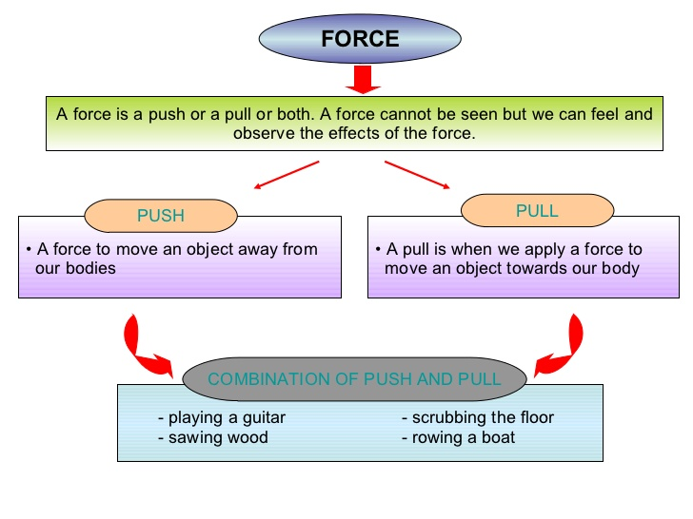

Slide 4
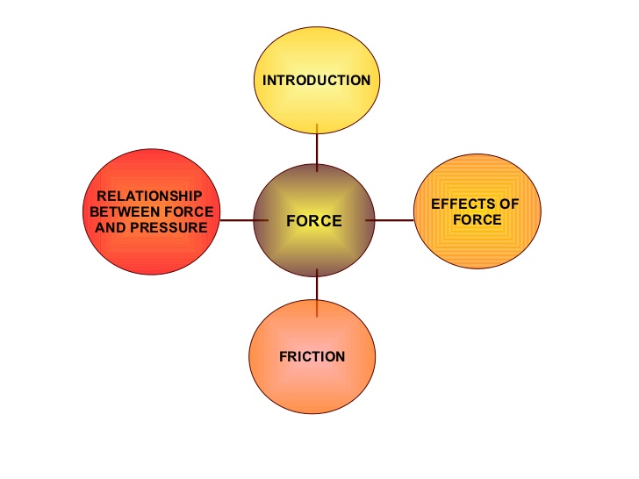

Slide 5
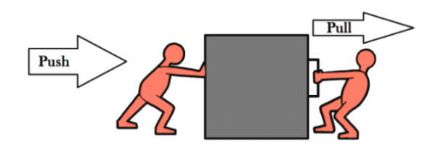
Push
A push is a force exerted away from the body, e.g: Hitting a snooker ball, kicking a football.
Magnetic force
The force of attraction or repulsion between two magnetic bodies due to their poles is known as a magnetic force.

Slide 6
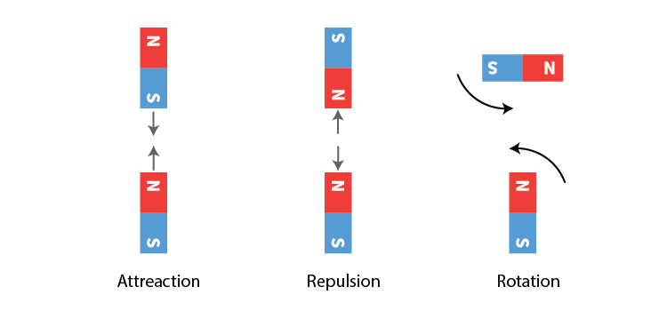

Slide 11
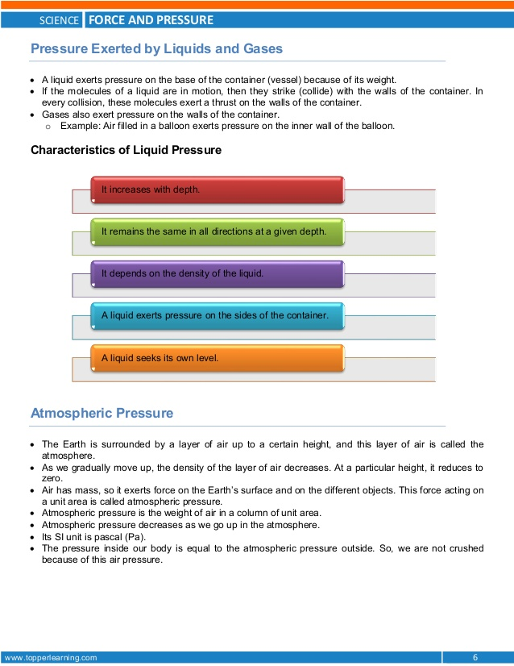

Slide 12
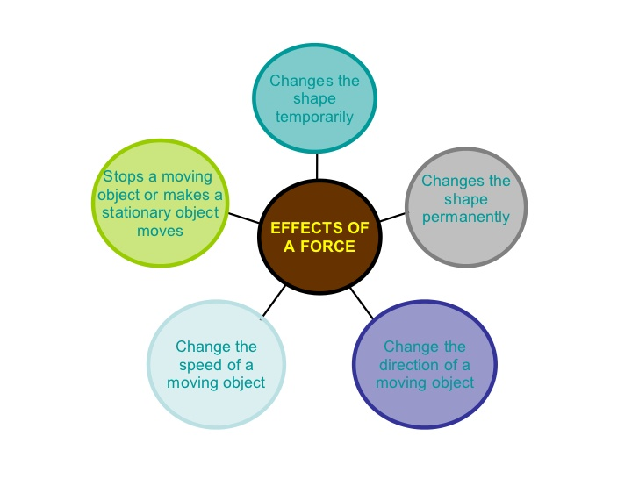

Slide 20
